Slide 1

Compact X-Ray Free-Electron LASER
What David did on his summer vacation…

Slide 2
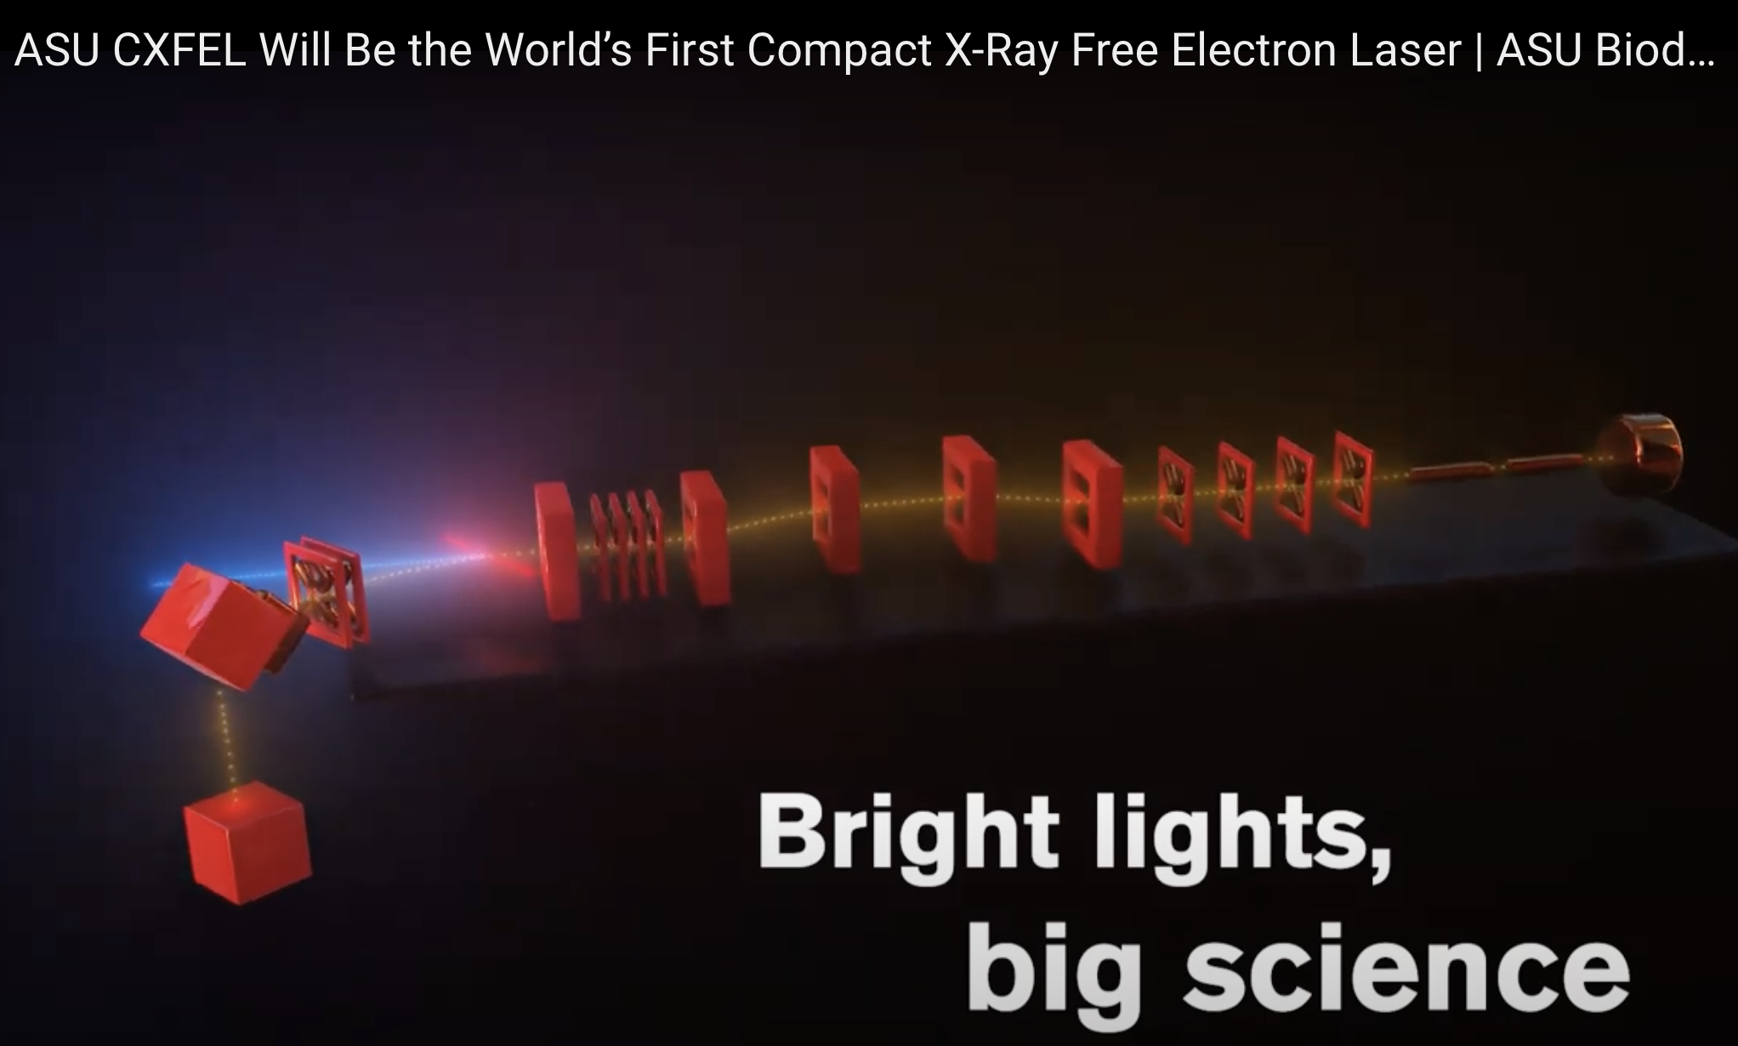
https://www.youtube.com/watch?v=HLF2sv78fiQ&t=4s

Slide 3
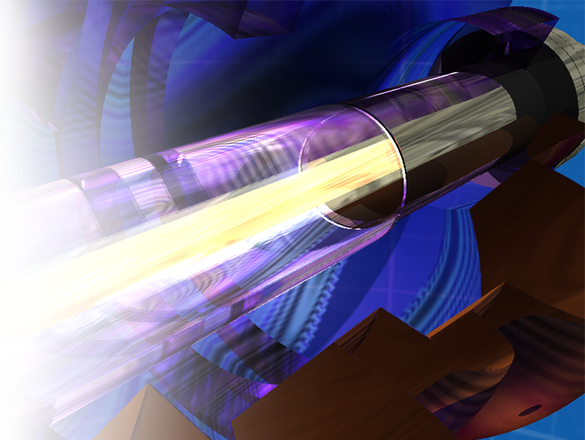
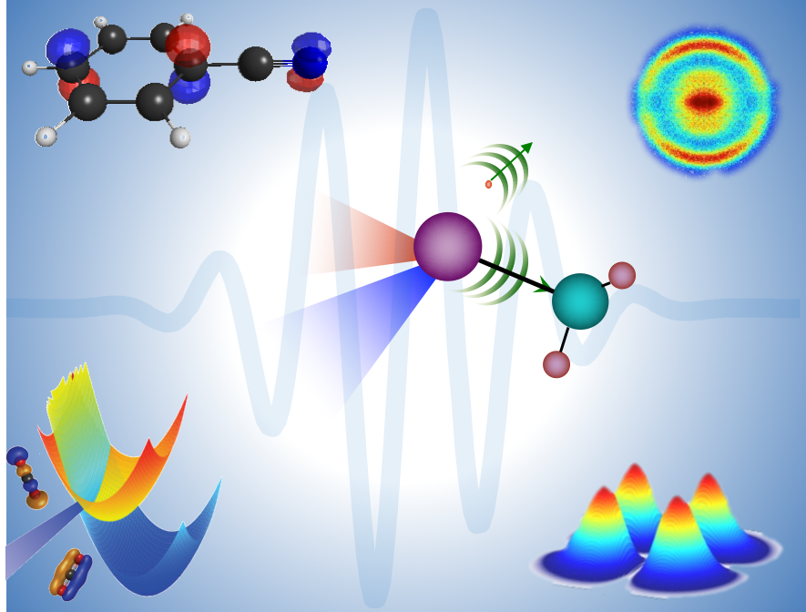
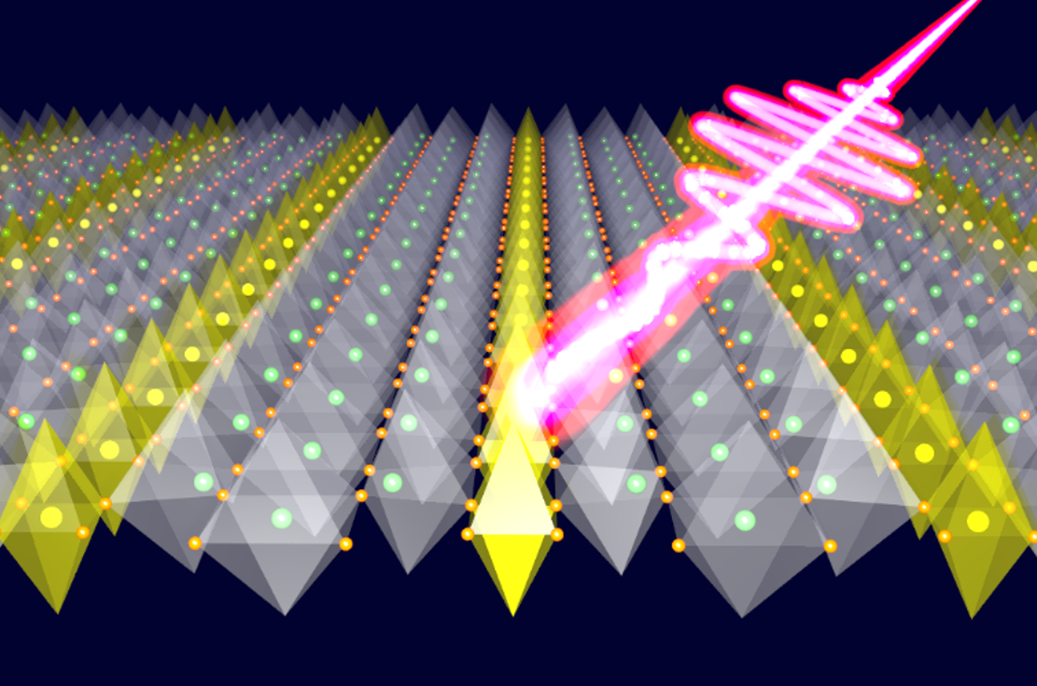
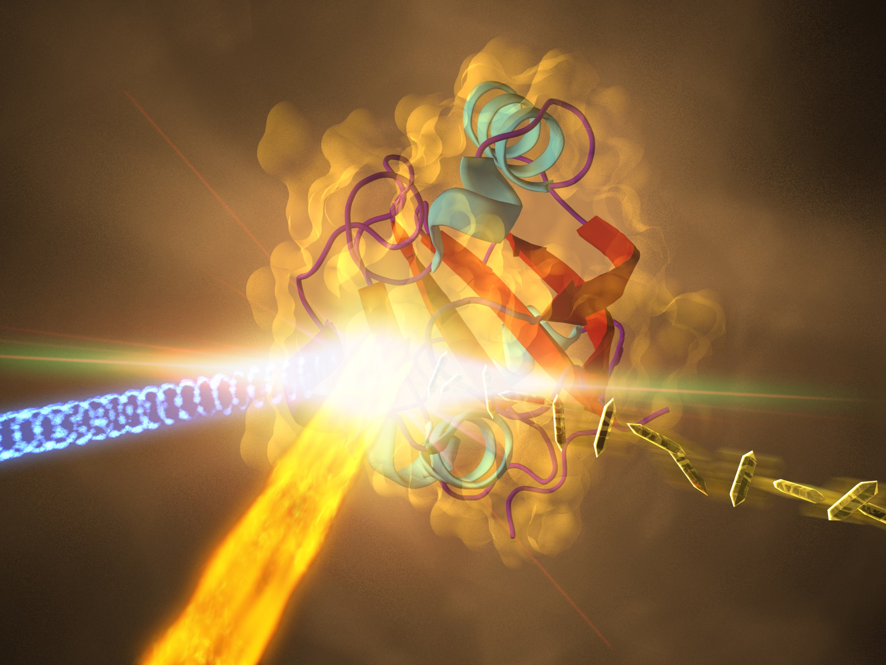
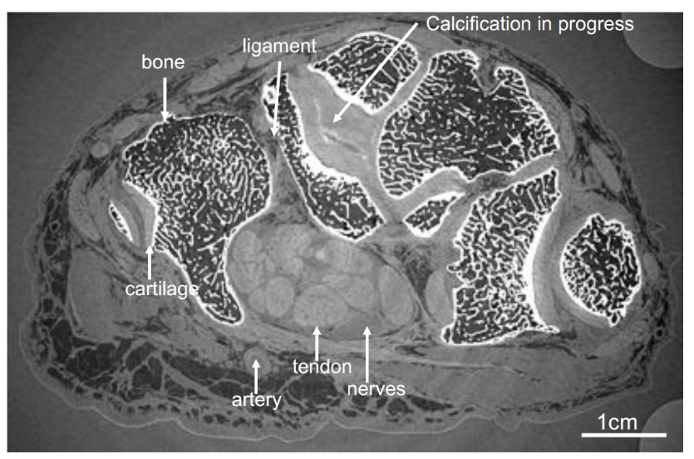
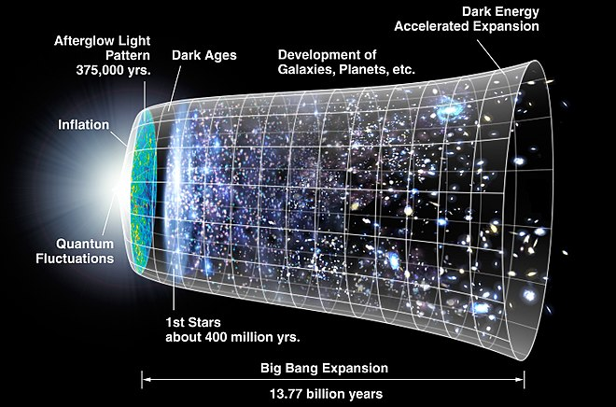
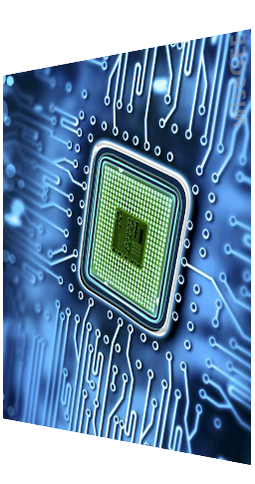

Science with Ultrafast & Coherent X-rays
Catalysis & Renewable Energy
Quantum Materials
Next-Generation Electronics
Biomolecular Movies
(Pharmaceutics, Photosynthesis,..)
Advanced Imaging (Medical,
Forensics,
Cultural Heritage,…)
Matter in Extreme Conditions
3

Slide 4
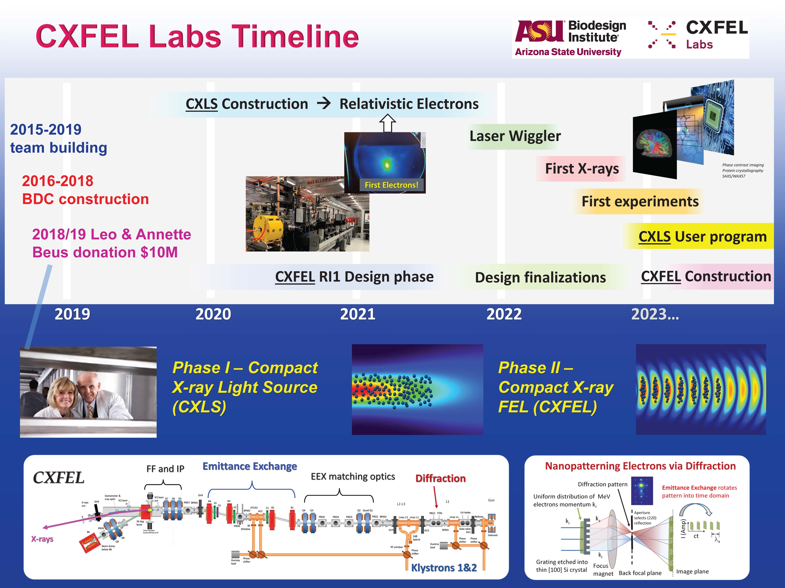

Slide 5
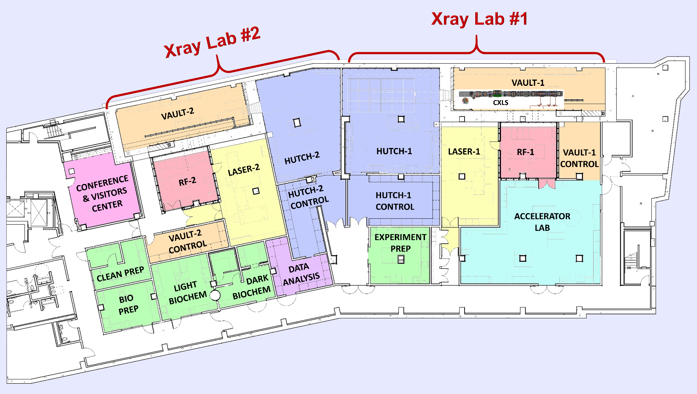
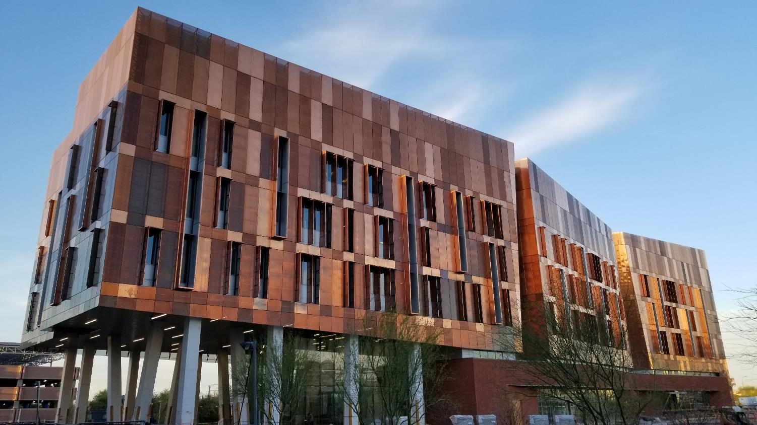
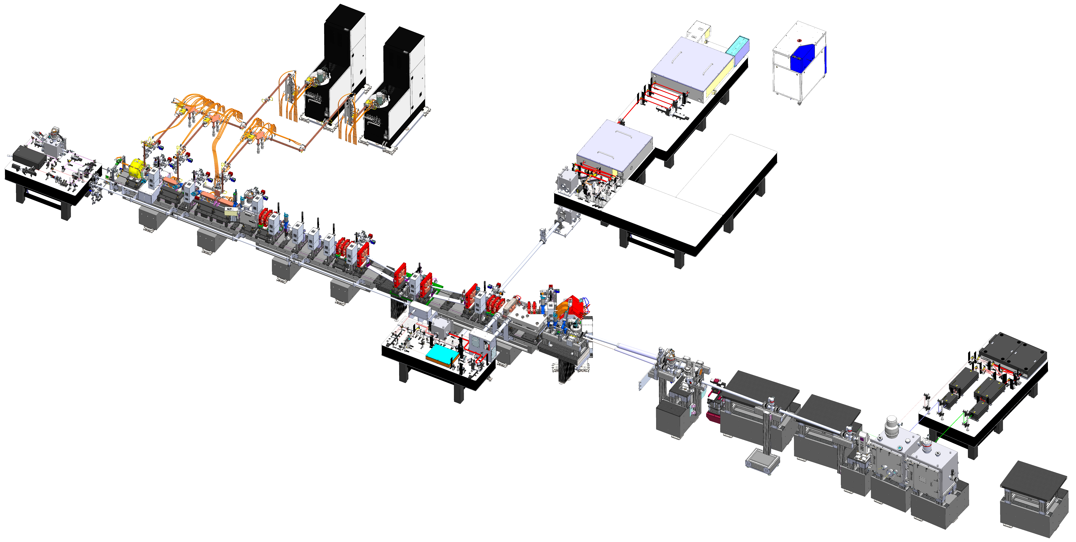
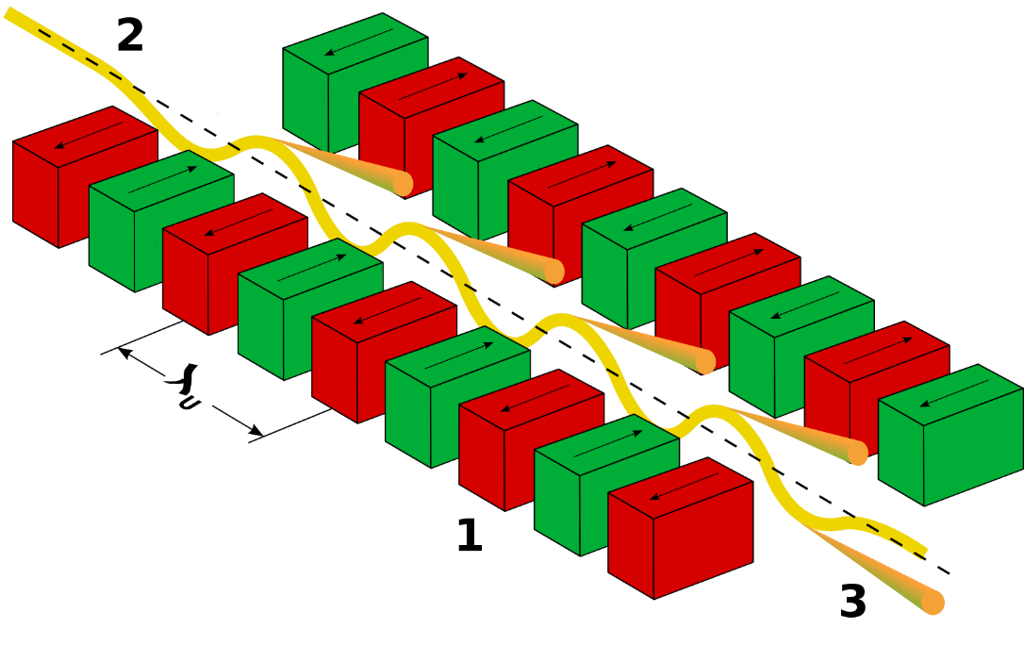
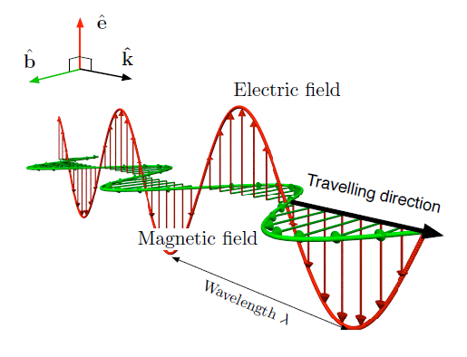
Beus Compact X-ray FEL (CXFEL) Labs at ASU
Hard X-ray suite (CXLS)
Soft X-ray suite (CXFEL)
Biodesign C building (2018)
~12,000 ft² customized space for CXFEL labs
LightConversion Yb:KGW
1030/515/258 nm
1.5 mJ/shot at 1030
0.15 mJ/shot at 258
200 fs
1 kHz
Scandinova solid-state modulators, L3Harris klystrons
9.3 GHz
6 MW for 1 µs at 1 kHz
<100 ppm stability
Trumpf Yb:YAG
1030 nm
200 mJ/shot
1 ps
1 kHz
M² = 1.2
Compact X-ray sources:
Replace periodic “undulator” magnets with intense
ultrashort light pulses
Diagnostics and matching quad triplets
X-ray Chambers
108 photons/shot
1-40 keV
300 fs
1 kHz
chicane
compressor
Beam Dump
Pump Laser
ASU-TibaRay
Photoinjector
9.3 GHz
1 kHz
120 MV/m
4.5 cell
4 MeV energy
200 pC
1 ps
X-ray Phase Contrast Imaging
Electron diffraction
TibaRay linacs
9.3 GHz standing wave
1 kHz
25-30 MV/m
20 cells/section (3 sections)
30 MeV final energy
Final focus and interaction point
λ
Image source: Wikipedia, LibreTexts
Shorter wavelength → reduced electron beam energy
CXLS length is 10 m from photoinjector to beam dump
5

Slide 6
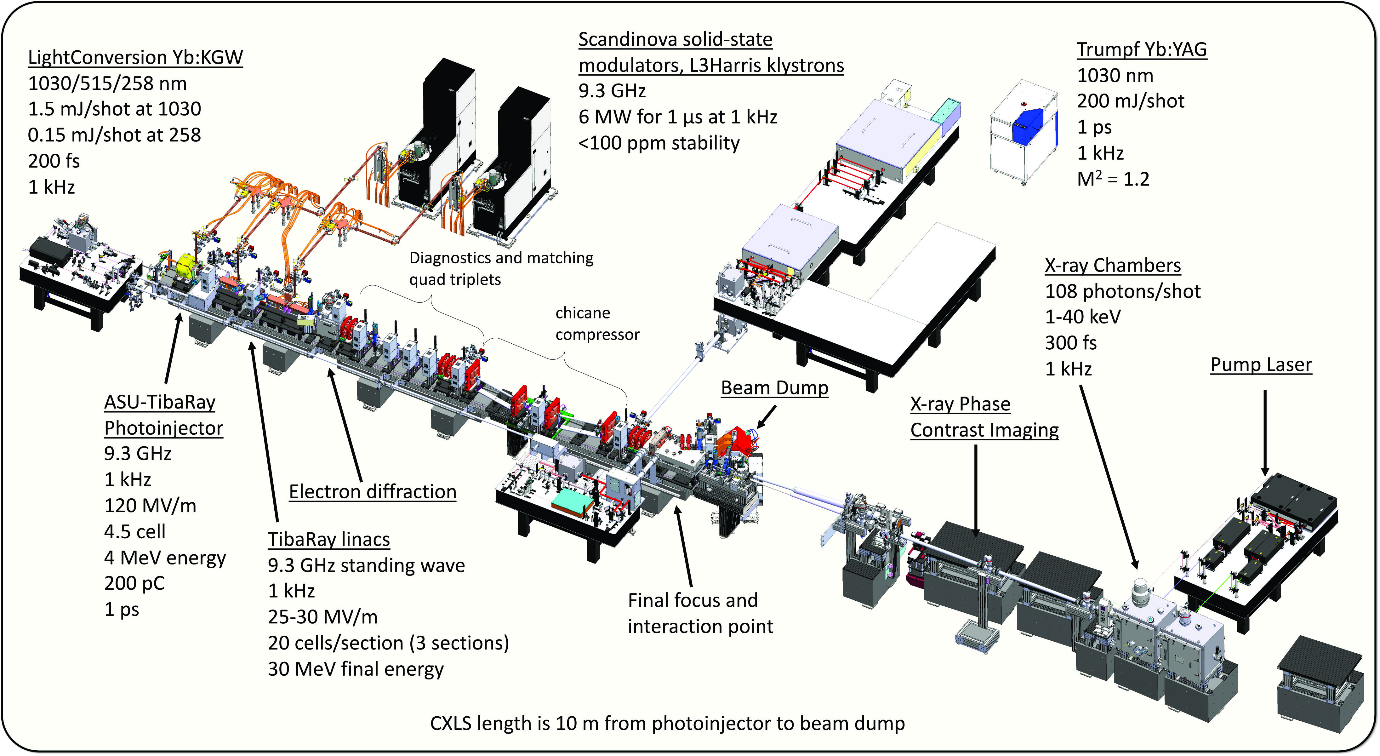

Slide 7
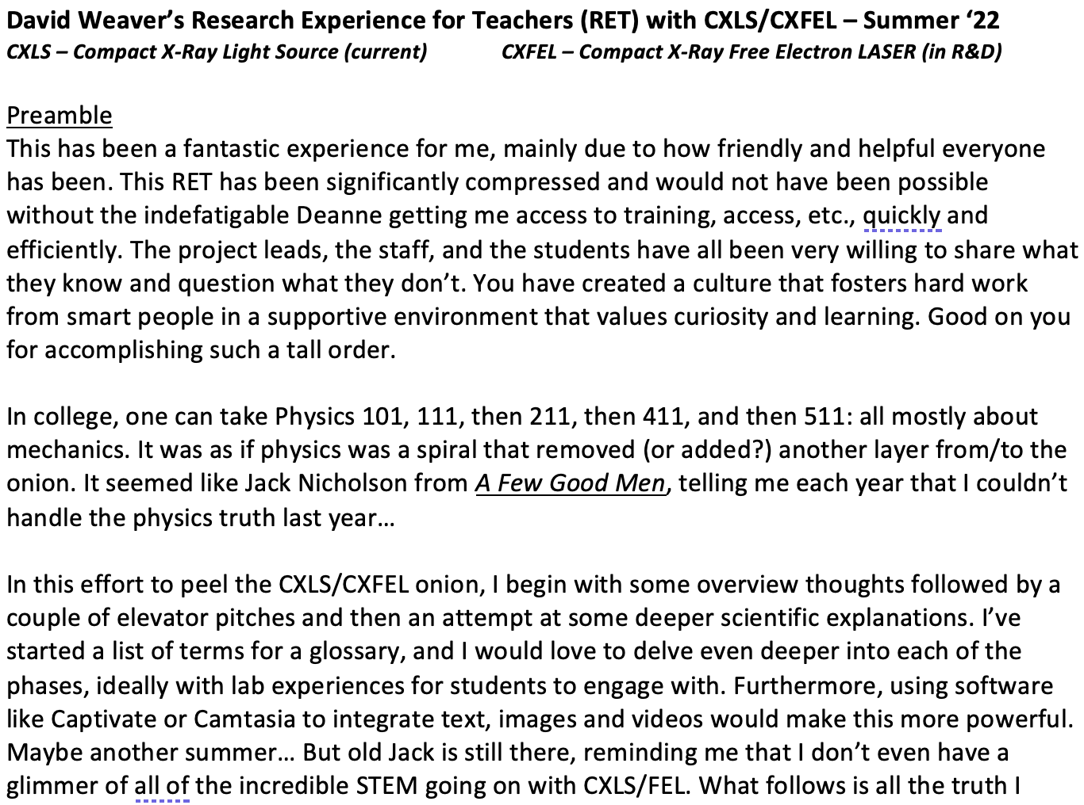

Slide 8
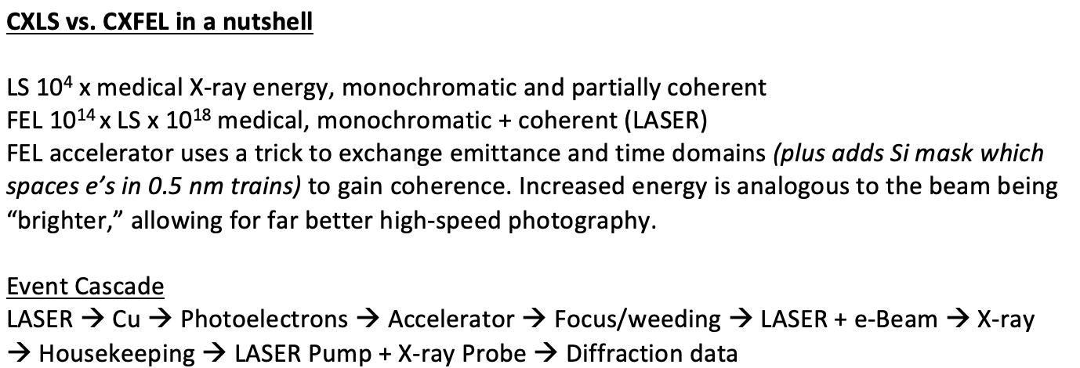

Slide 9
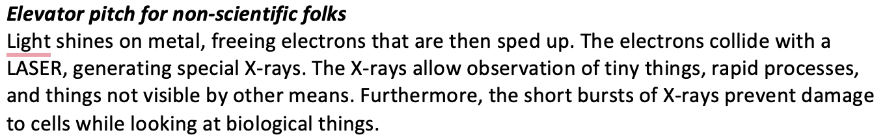

Slide 10
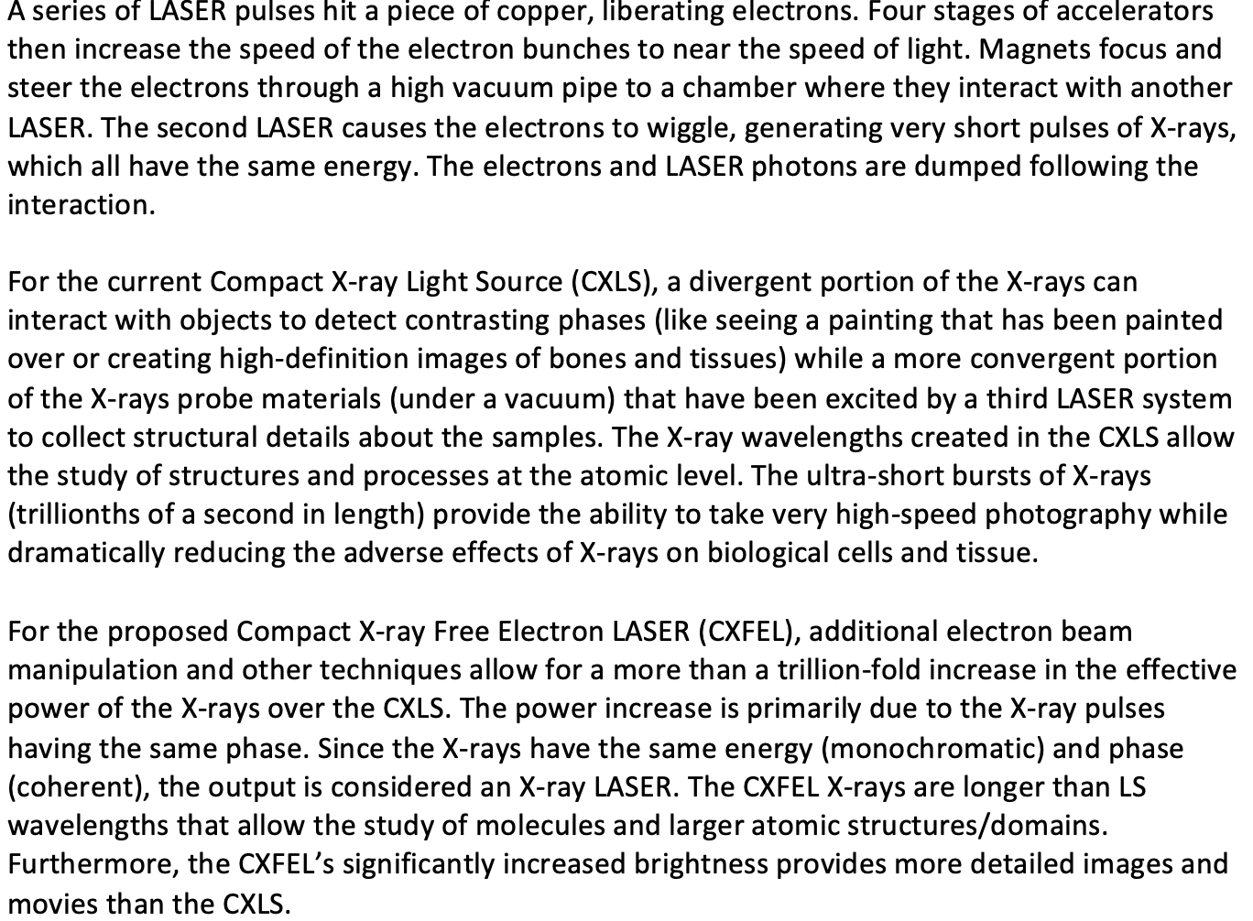

Slide 11
